Slide 1
Stat 626 Presentation Topic: Econometric Analysis of XOM stock
Group 1 :Gourav Ghoshal, Tzuhao Chin, Pranav Dharmadhikari, Ritvik Dhupkar, Maitrayee Atre

Slide 2
Group Members and Task Allocations
Name | Tasks
Ritvik Dhupkar (L) (Group Leader) | Coding, Presentation and report
Gourav Ghoshal (L) | Coding, Presentation and report
Maitrayee Atre (D) | Coding, Presentation and report
Pranav Dharmadhikari (D) | Coding, Presentation and report
Tzuhao Chin (D) | Coding, Presentation and report

Slide 3
Project Overview
Topic:- Econometric Analysis of Exxon Stock Price (XOM) Data
Part I : Time Series Analysis of The Exxon Stock (XOM)
Part II : Multivariate Timeseries analysis of Stock with Other Variables like WTI (Barrel Price) and NYSE ACRA Oil & Gas Stock Market Index
Test For Causality of rise/ fall in Stock Prices. Does Change in WTI cause a change in Stock Price?
Data obtained from Yahoo Finance, FRED
Monthly Data used for analysis

Slide 4
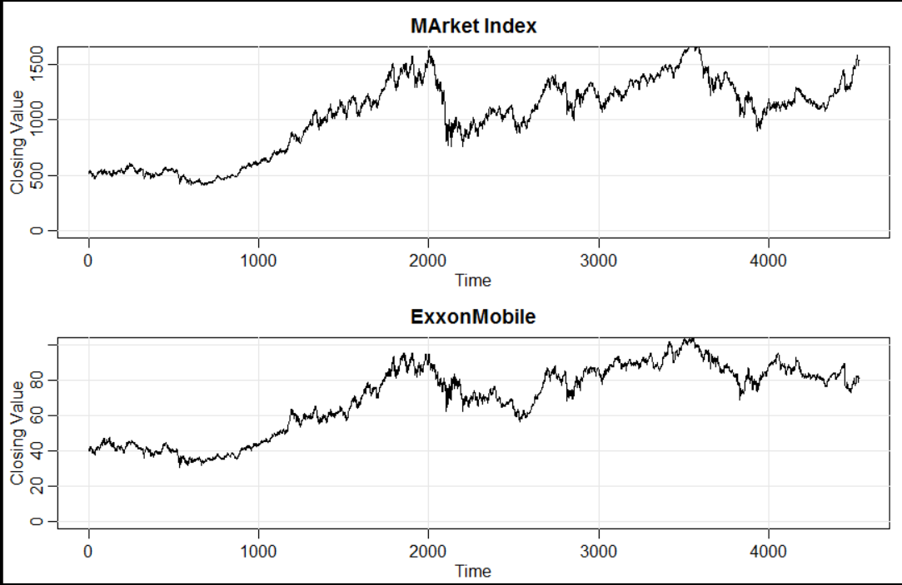
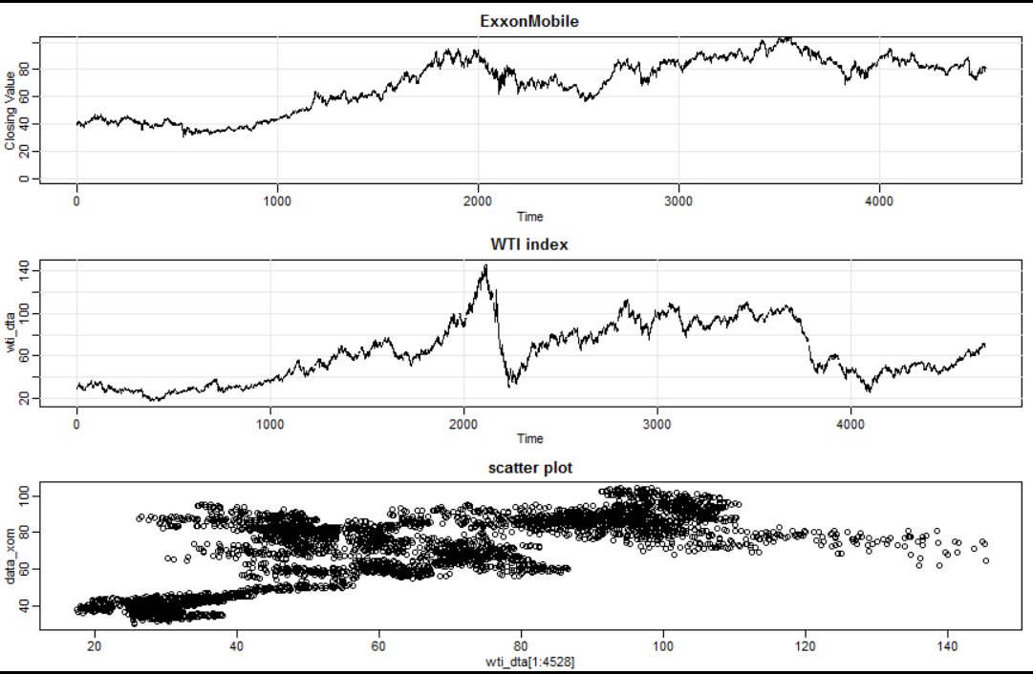
Timeseries Plots of Predictor Variables

Slide 5
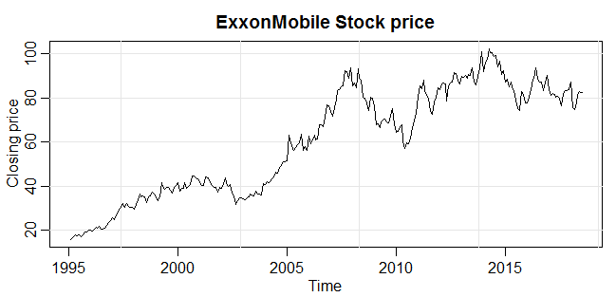
Modelling Exxon Stock Data
The Data is obtained from Yahoo Finance, Exxon monthly Stock Data

Slide 6
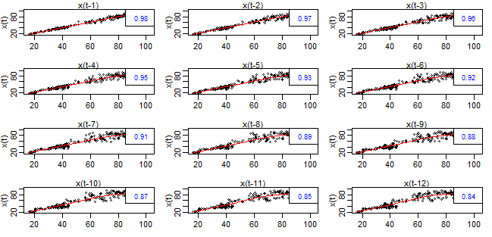
Part I: Time Series analysis of XOM Stock
Correlation plots of XOM with itself at various lag intervals

Slide 7
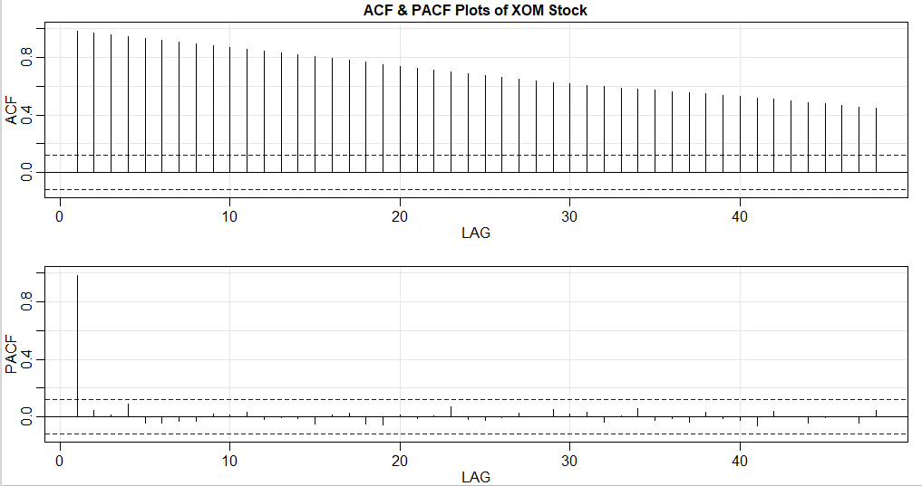
ACF and PACF Plot of Exxon Stock (XOM)
Significant Correlation well beyond 4 years !!

Slide 8
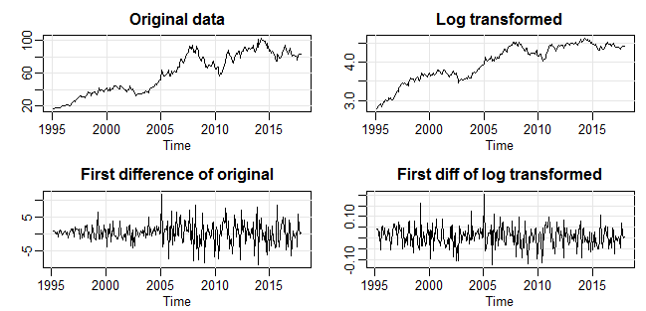
Transformations on XOM Stock
The First difference and first difference of log resembles white noise
Existence of Some Cyclicity
Notes:
From the above slide we can see that the first difference of the data, looks very much like a white noise process.

Slide 9
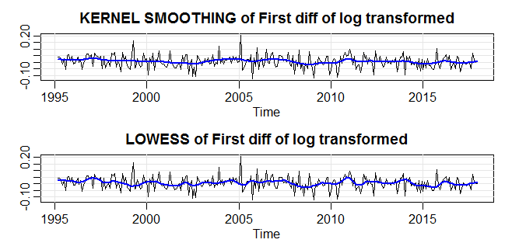
Smoothing data to recognize long term trends
Evidence of Cyclicity Present

Slide 10
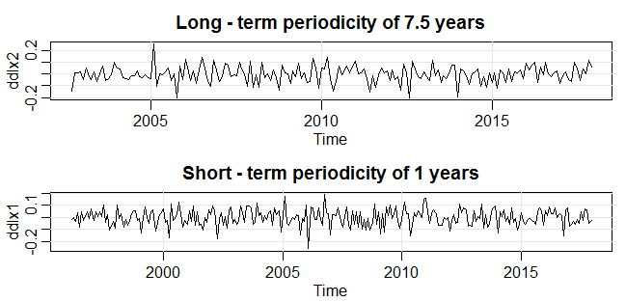
Detecting Periodicity
Short term - differencing of 12 months looks like white noise
Let’s decompose to see further

Slide 11
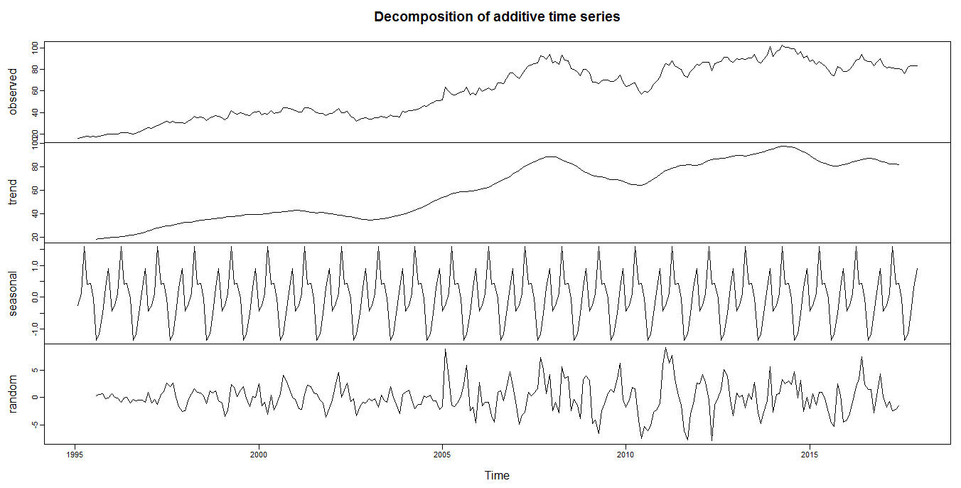
Decomposing Trends
Increasing trend and Annual Seasonality
Stock price is high in quarter 2 and low in quarter 3, with quarter 1 and 4 being intermediate

Slide 12
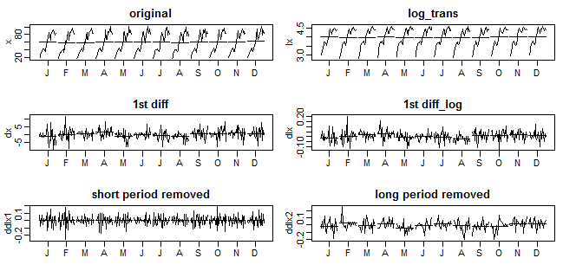
Monthplot
See Short and Long- term periodicity in first difference

Slide 13
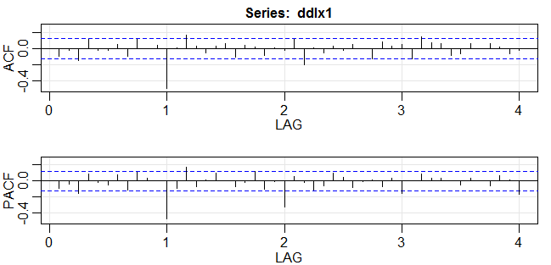

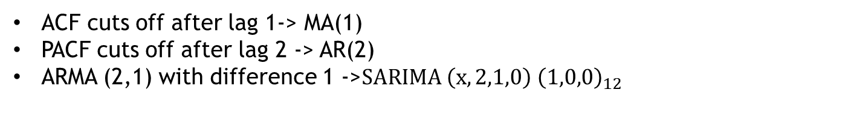
ACF and PCF of $Δ^{2}(\log\left(XOM\right))$
ACF cuts off after lag 1-> MA(1)
PACF cuts off after lag 2 -> AR(2)
ARMA (2,1) with difference 1 ->$SARIMA \left(x, 2,1,0\right) {\left(1,0,0\right)}_{12}$

Slide 14
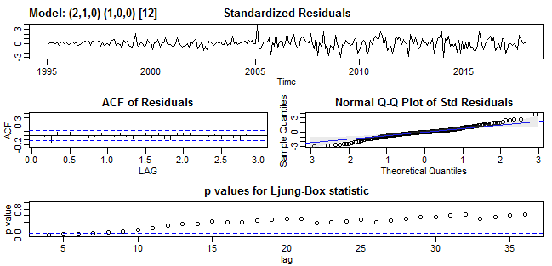

Analysis of Model1-> $$SARIMA \left(x, 2,1,0\right) {\left(1,0,0\right)}_{12}$$
First difference taken considering periodicity of 12 months

Slide 15
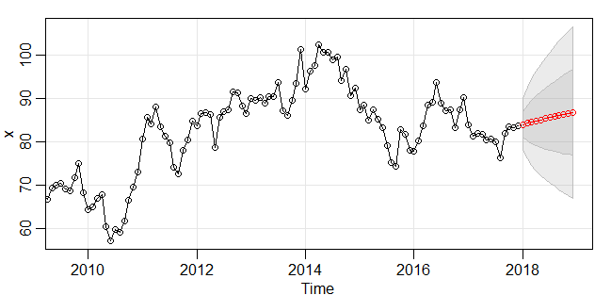
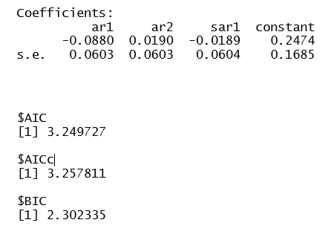

$SARIMA \left(x, 2,1,0\right) {\left(1,0,0\right)}_{12}$Model Parameters Prediction
Forecast
Coefficient

Slide 16
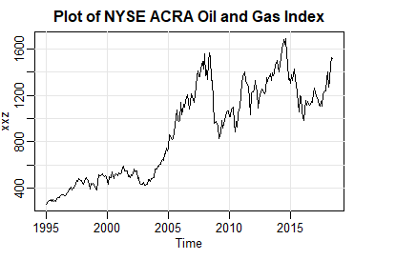
Part II: Regression Analysis of Exxon Stock with NYSE ACRA Index (XOI)
Plot Of NYSE ACRA Oil Index
Weighted Index of Stock Prices of a
Number of O&G Companies
Exxon Mobil Significant part of the
Index

Slide 17
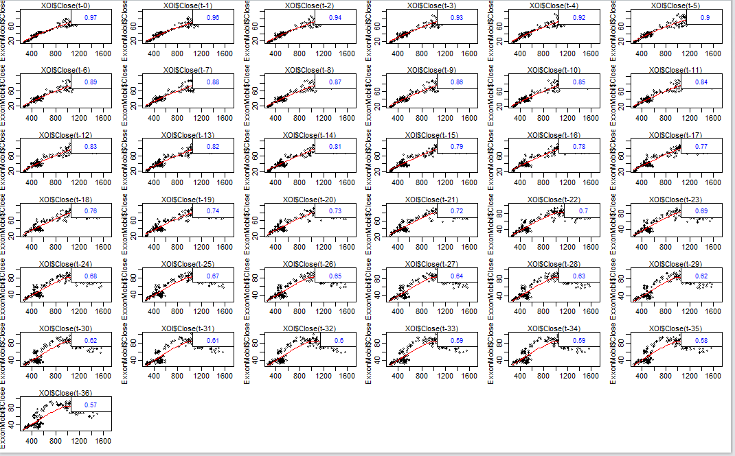
Cross- Correlation Plot of XOM stock and XOI Index (lagged)

Slide 18
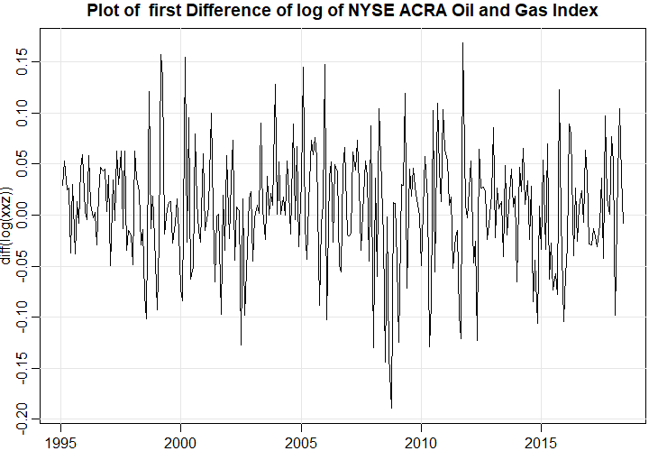
First Difference Plot of XOI index

Slide 19
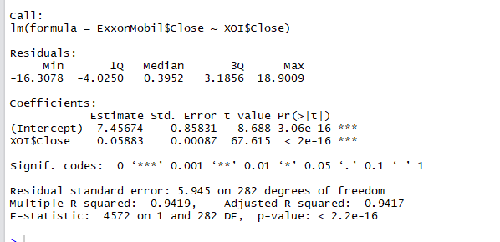

Regression Analysis of XOM vs XOI (Model 1)
Model 1 - $XOM_{t}=β∗XOI_{t}+e_{i}$

Slide 20
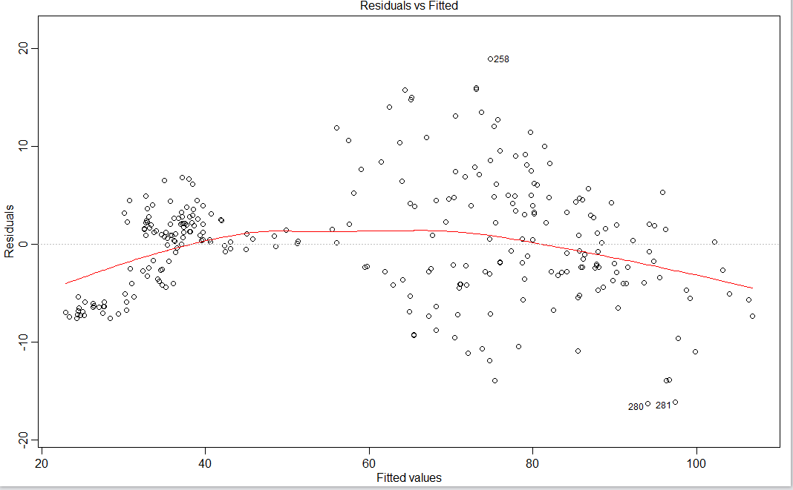
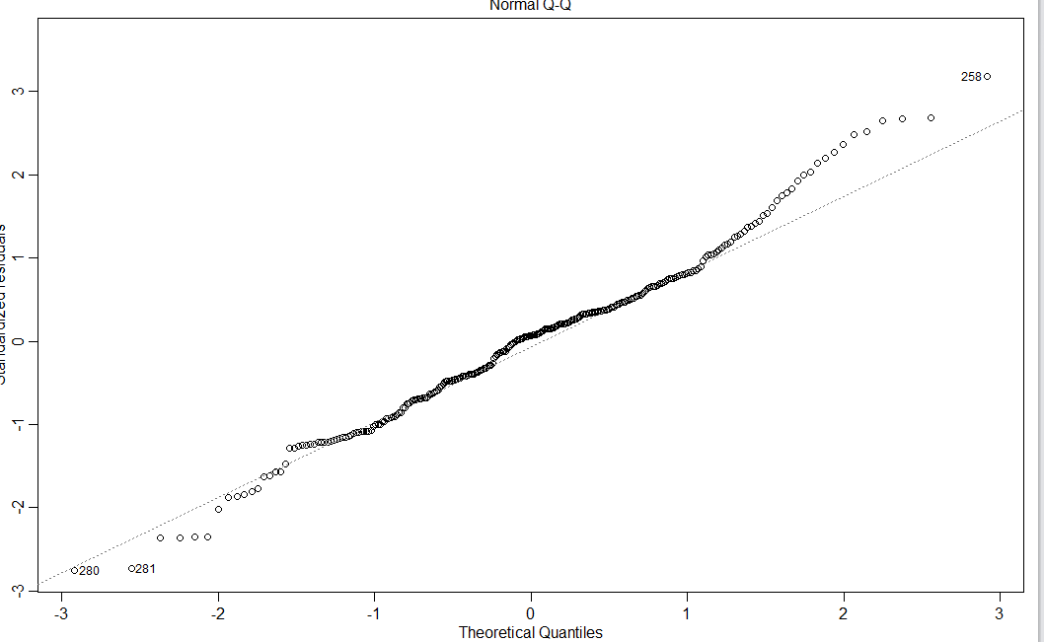
Diagnostic Plots
Residual Vs fitted
Normal Q-Q Plot

Slide 21
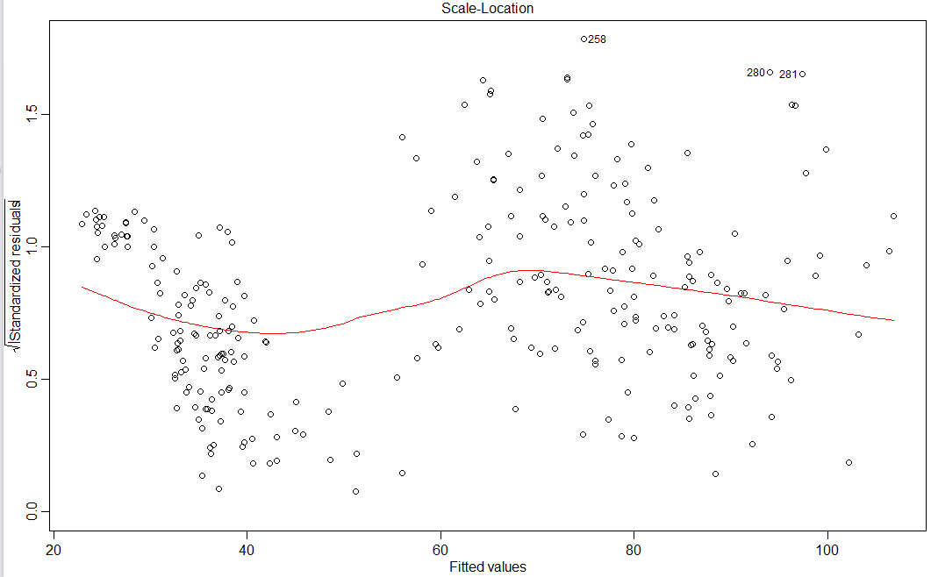
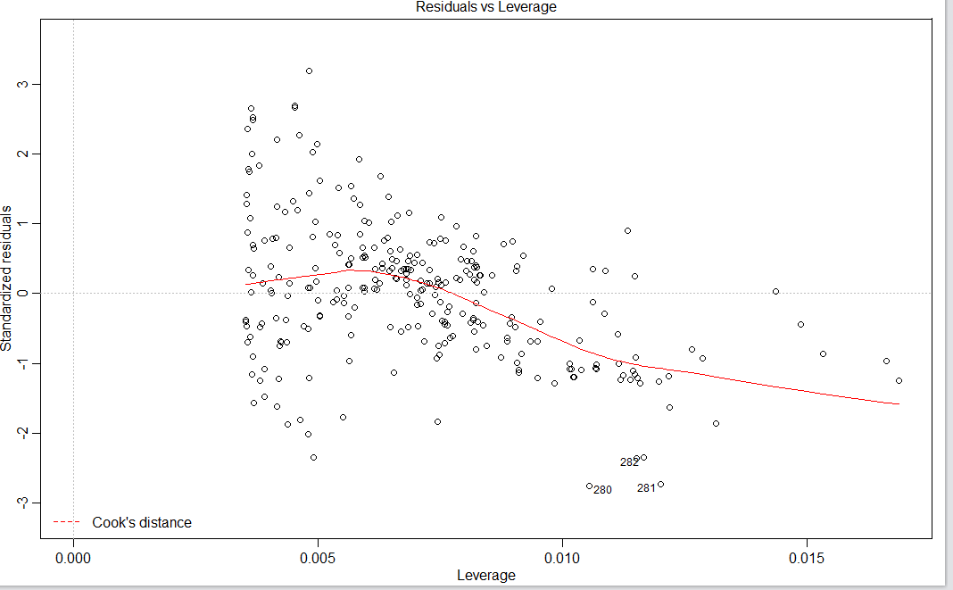
Diagnostic Plots (Part 2)
Cooks Distance
Sqrt(Residuals) vs Fitted

Slide 22
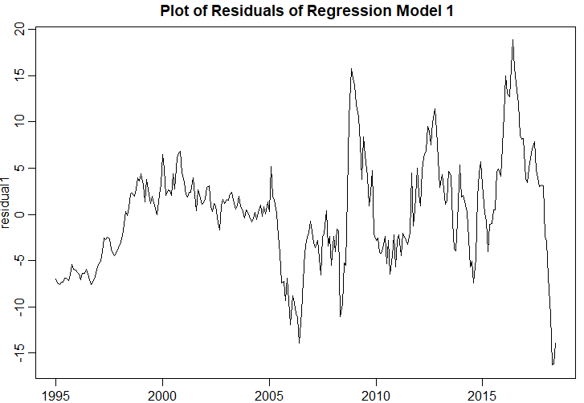

Timeseries plot of residuals $(e_{i})$
Not a White Noise Process!!!

Slide 23
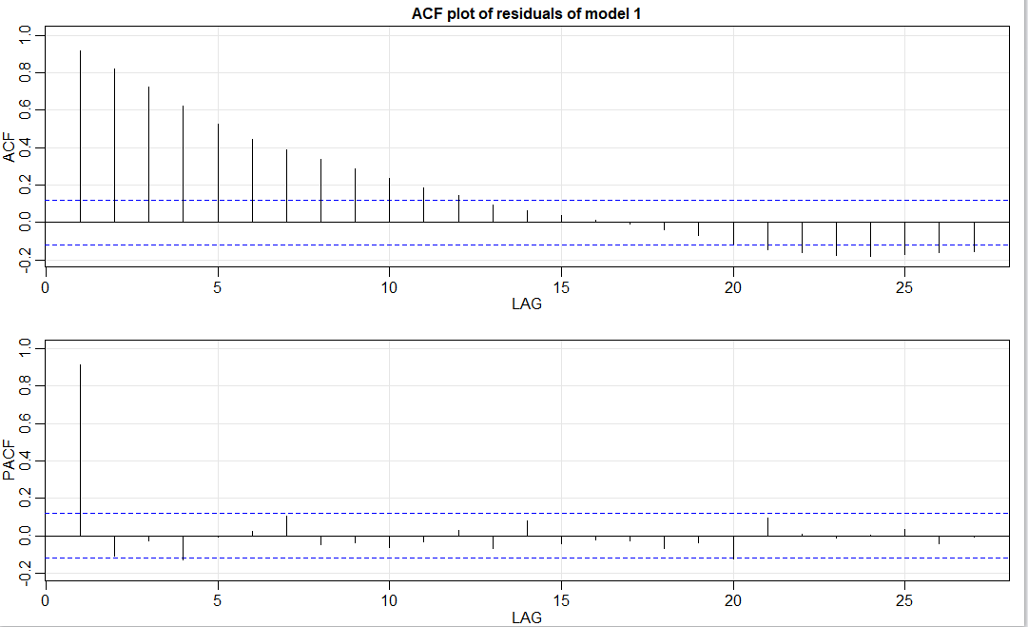
Model 1 :- ACF & PACF plots of Residuals

Slide 24
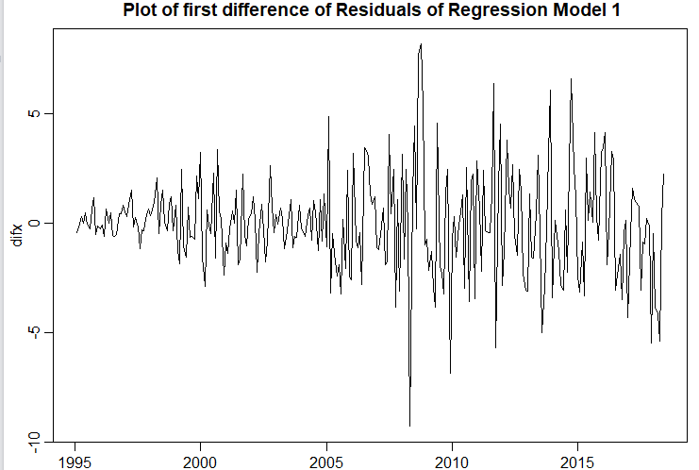

Plot of $Δe_{i}$
Closer to a White noise Process!!

Slide 25
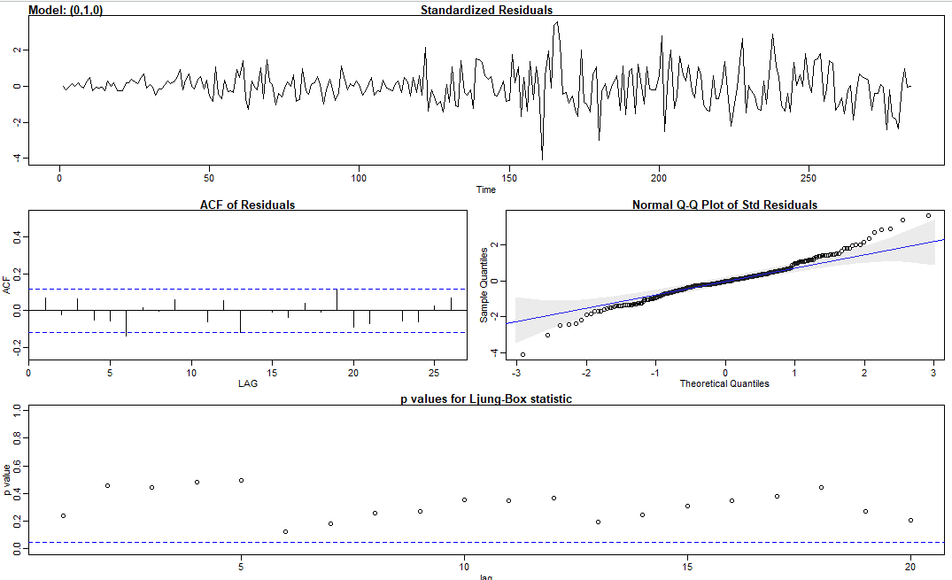
Plot Of first difference of Residuals ARIMA(0,1,0)
Model - $e_{t}−e_{t−1}=w_{t} is White Noise$

Slide 26
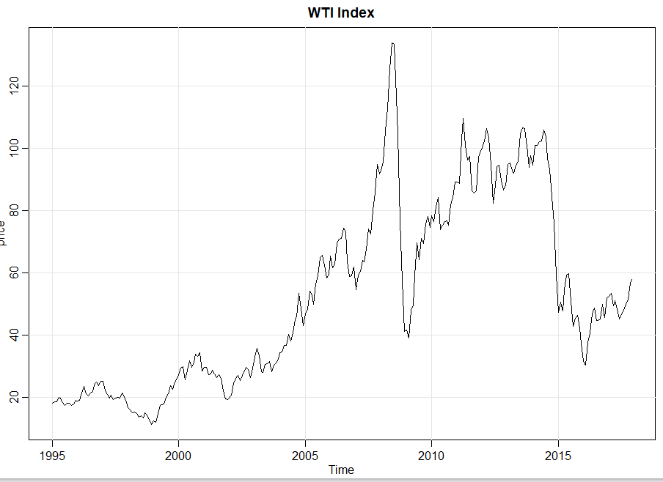
Model 3 – Regression of XOM with WTI ( Barrel Price)

Slide 27
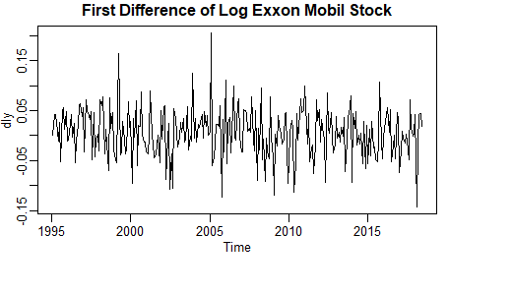
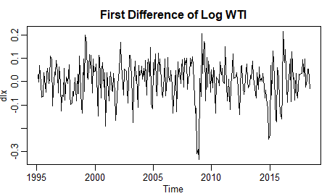
WTI Transformed Plots

Slide 28
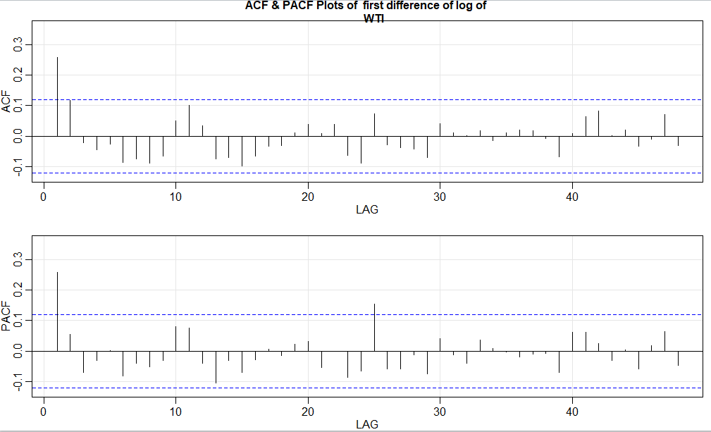

ACF of $Δ(\log{WTI}))$
Lag 1, Lag 24 are significant in ACF

Slide 29
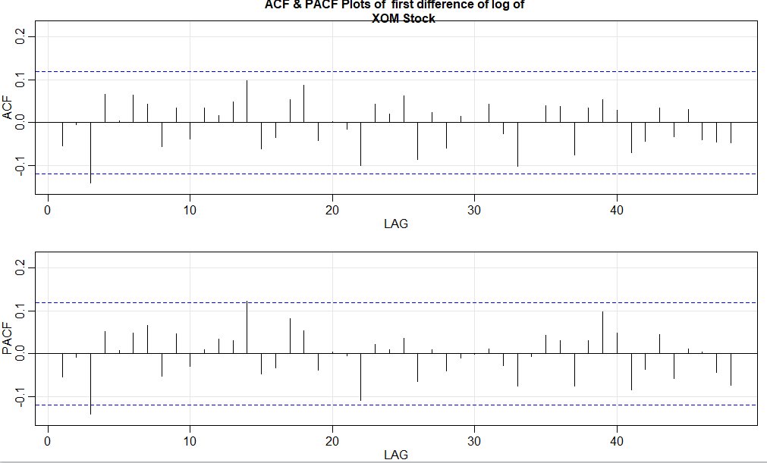
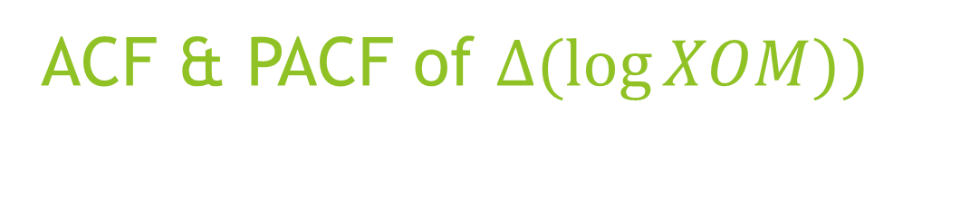
ACF & PACF of $Δ(\log{XOM}))$
Lag 1 is significant in ACF

Slide 30
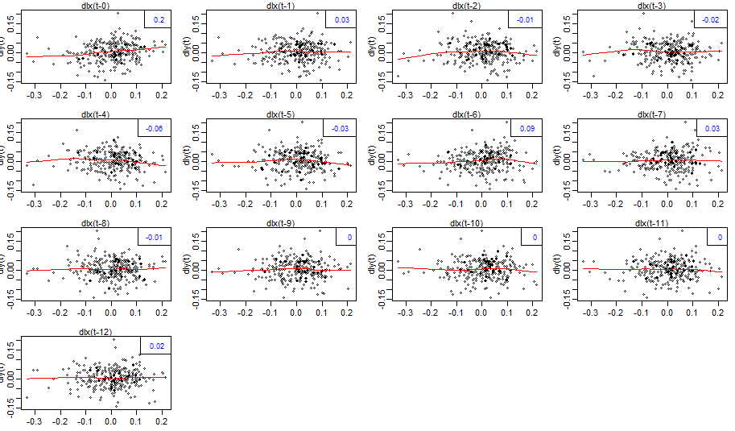

Correlation of $Δ\log\left(XOM\right)$with lags of $Δ\log\left(WTI\right)$

Slide 31
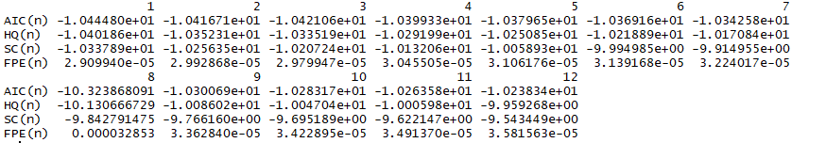
Vector Autoregression of WTI and XOM
Model Selection done on the basis of Schwarz Criteria (BIC)
Lowest BIC for lag 1

Slide 32
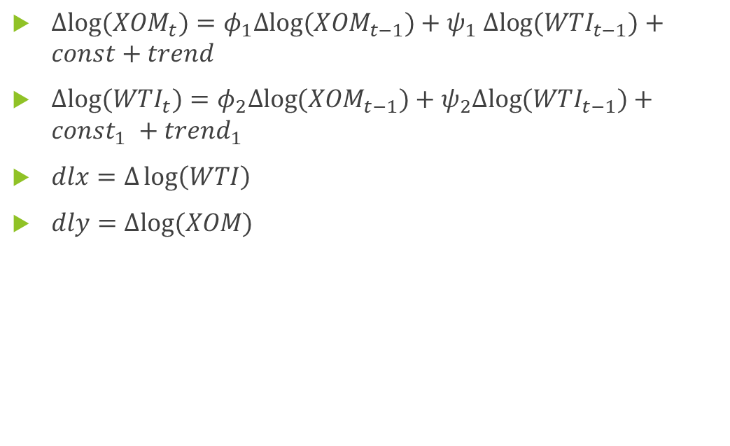
Vector Autoregression Equations
$Δlog⁡(XOM_{t})=φ_{1}Δlog⁡(XOM_{t−1})+ψ_{1} Δlog⁡(WTI_{t−1})+const+trend$
$Δlog⁡(WTI_{t})=φ_{2}Δlog⁡(XOM_{t−1})+ψ_{2}Δlog⁡(WTI_{t−1})+const_{1} +trend_{1}$
$dlx=Δ\log\left(WTI\right)$
$dly=Δlog⁡(XOM)$

Slide 33
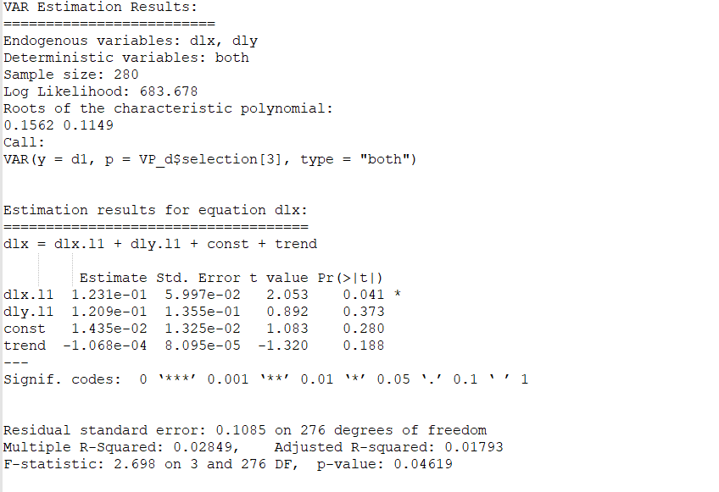

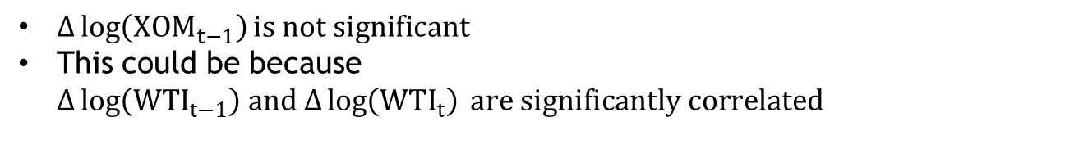
$Δ\log\left(WTI\right)$ as Target variable
$Δ\log\left(XOM_{t−1}\right)is not significant$
This could be because $Δ\log\left({WTI}_{t−1}\right) and Δ\log\left(WTI_{t}\right) are significantly correlated$

Slide 34
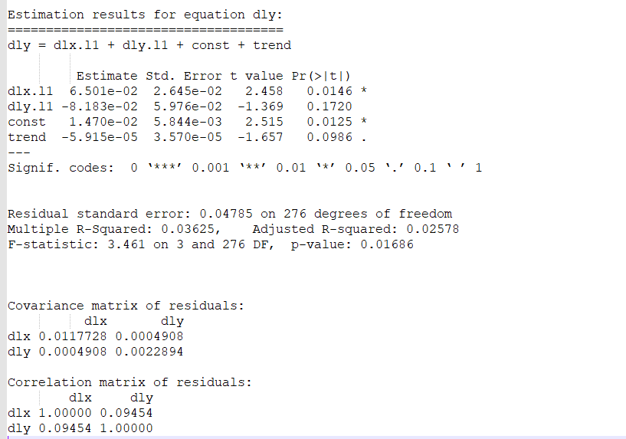

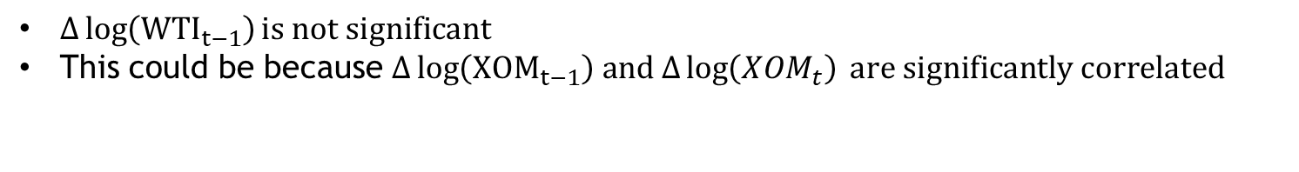
$Δ\log\left(XOM\right)$as target variable
$Δ\log\left({WTI}_{t−1}\right)is not significant$
This could be because $Δ\log\left({XOM}_{t−1}\right) and Δ\log\left(XOM_{t}\right) are significantly correlated$

Slide 35
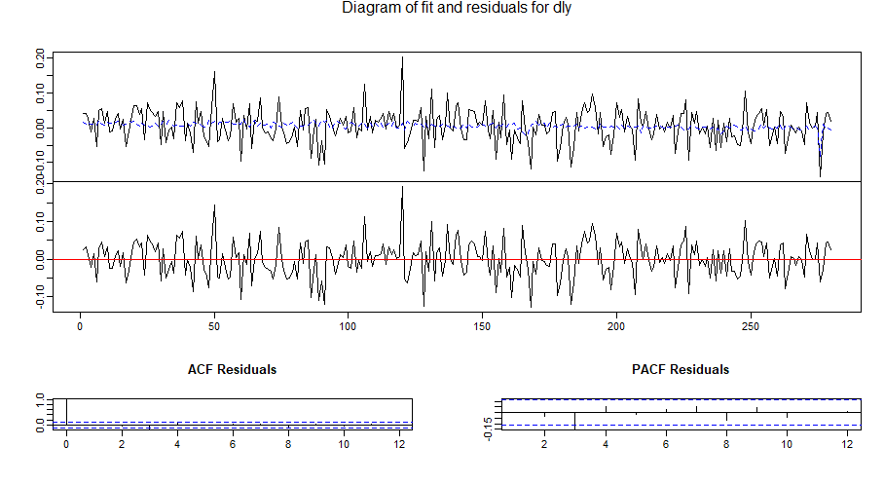

Model Results $Δ\log\left(XOM\right)$
Notes:
XOM as target variable

Slide 36
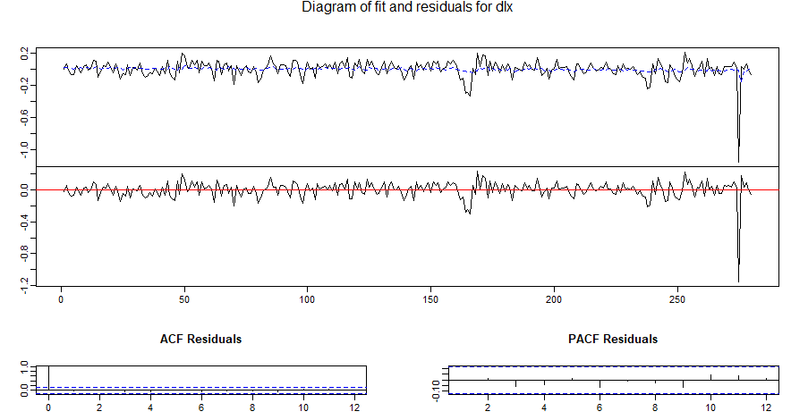

Model Results $Δ\log\left(WTI\right)$

Slide 37
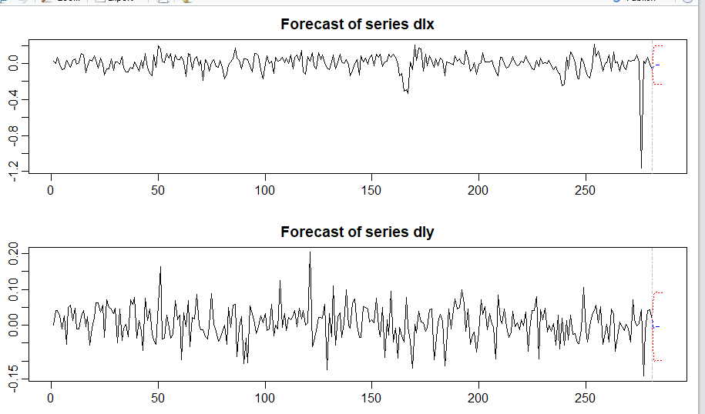
Predictions of VAR (Vector Auto Regression)

Slide 38
Future Steps
Investigating Seasonality of Data
Further Diagnostics and investigation on VAR model
Conducting Inference on VAR model
Testing for Causality

